Slide 1
User guide for OneDrive

Slide 2
This user guide will show you how to get started on OneDrive, including:
How to logon to OneDrive for the first time
How to navigate OneDrive
How to upload and save documents to OneDrive
How to create documents in OneDrive​
How to share documents on OneDrive

Slide 3
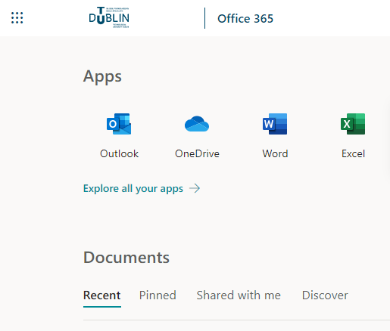
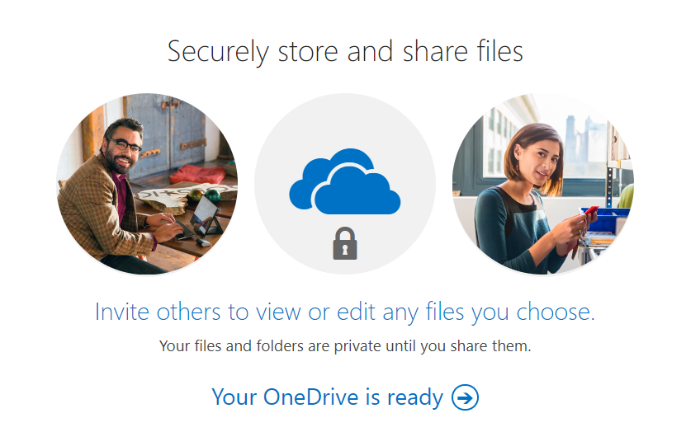
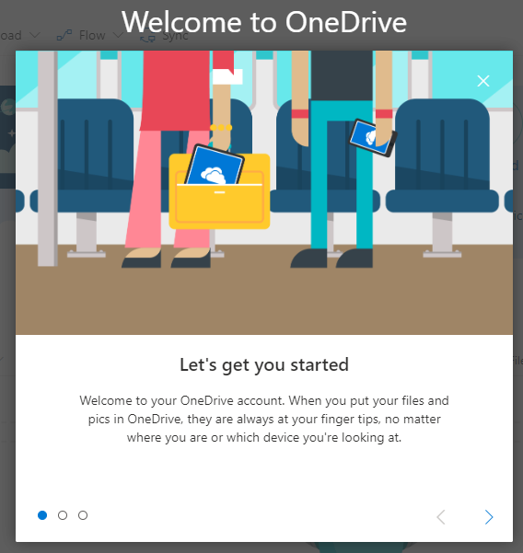
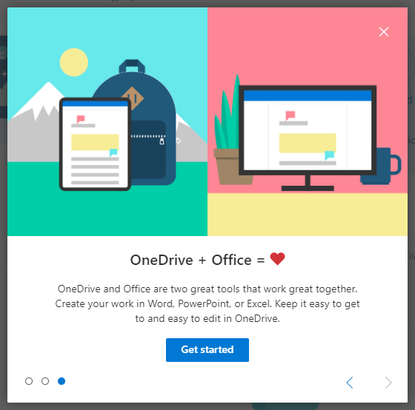
How to login to OneDrive for the first time
Find the OneDrive icon in the Office 365 portal.
When prompted click Your OneDrive is ready.
Click Next on the Welcome to OneDrive slides and then click on Get started.
You will now see the OneDrive landing page.

Slide 4
How to login to OneDrive for the first time continued
You will see a OneDrive mission pop-up on the main landing page for OneDrive which will guide you on how to set up OneDrive on both your mobile and your desktop and show you how to upload files and photos.
6. You can exit this by clicking on the X on the top right of the box.

Slide 5
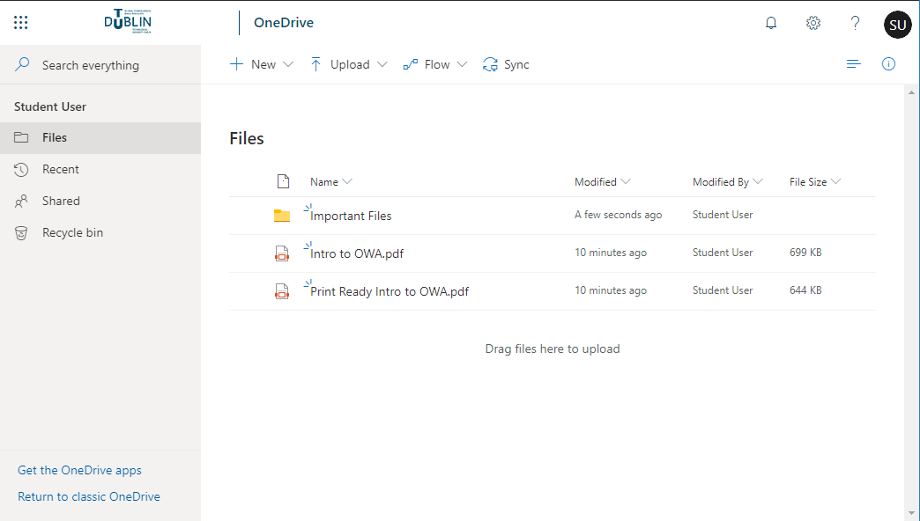
How to navigate OneDrive
6
7
1
Office365 Navigation: This is where you can click to navigate to other Office 365 Applications
Search: This is your search tool. Type what you want to search here.
Folder Navigation: This is where you navigate through your files.
Files and Folders View: This is the main navigation element in OneDrive. You can navigate between files and folders and see further information on your files and folders.
Bottom Navigation: This gives you the option to get the OneDrive App or return to the classic view of OneDrive (not recommended).
Task Bar: This is where you can upload documents and create new ones.
Settings: This is where you can personalize your account and gain access to additional tools and customization options.
2
3
4
5

Slide 6
How to upload files to OneDrive
You can upload documents to OneDrive in a number of ways:
Drag and Drop
Use the upload button
Creating Documents in OneDrive

Slide 7
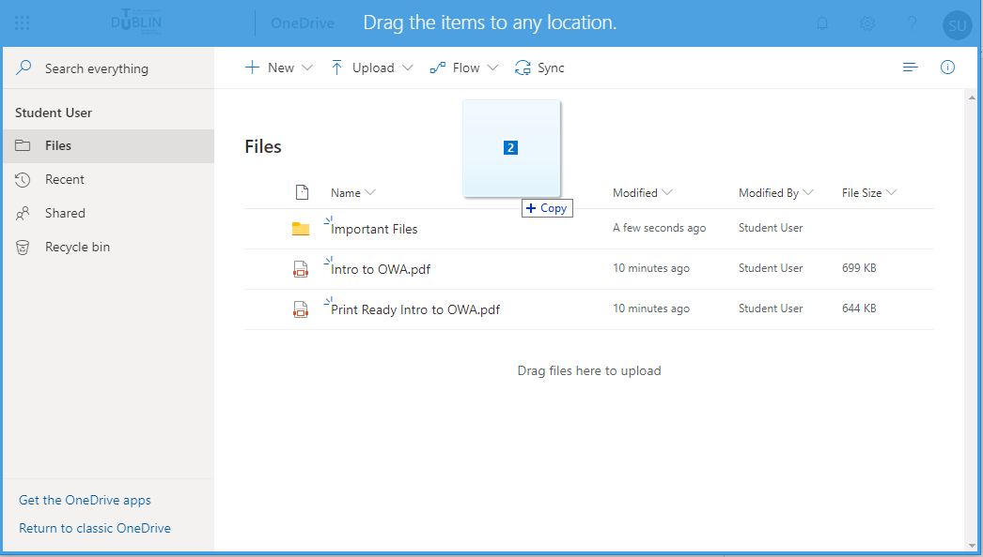
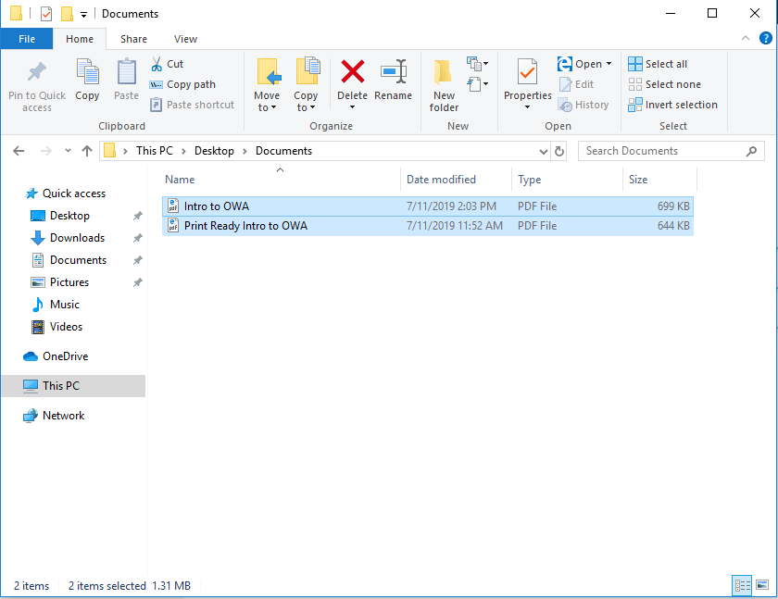
How to upload files using drag and drop
Navigate to the folder where you would like to place the files.
Open Windows Explorer and pick up the files you want to upload.
Drop the files into the browser window where you have OneDrive open.
You will see the top and the edges of the browser window turning blue indicating it recognizes that you are attempting to drop files in.
You will see the files appear in the OneDrive folder.

Slide 8
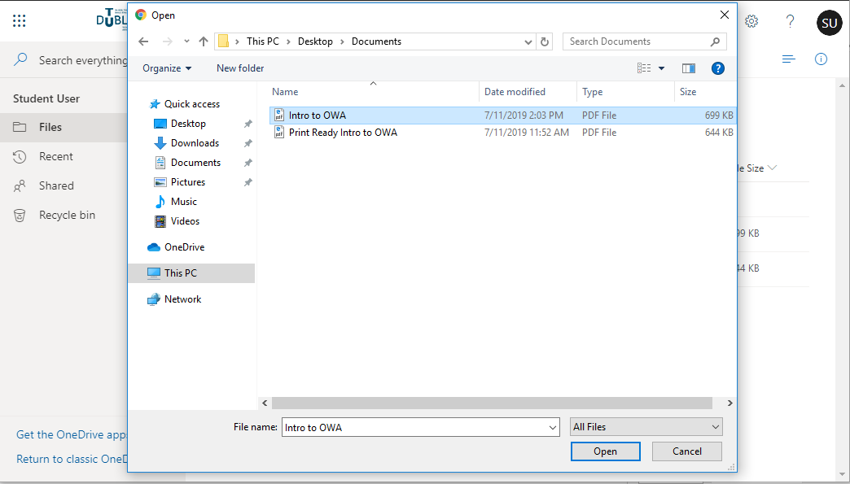
How to upload files using the upload button
Navigate to the folder where you would like to place the files.
Click the button in the task bar.
A Windows Explorer window will appear for you to select the files you want to upload.
Select the files you want to upload and click Open.
You will see the files appear in the OneDrive folder.

Slide 9
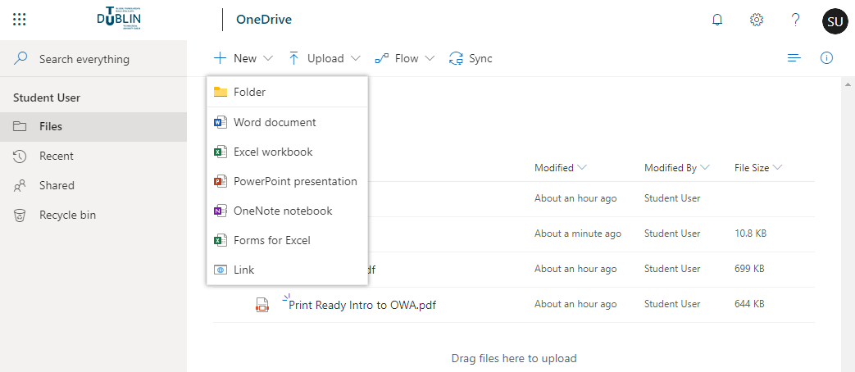
How to create documents in OneDrive
Navigate to the folder where you would like to create the file.
Click on in the task bar and create the type of document you wish to use (1).
Your new document will open in the web app associated with that file type.
To name your document you can click on the name (2) Document or Book on the top bar and rename it.
There is no need to press save as all changes are saved automatically on the web apps.
1
2

Slide 10
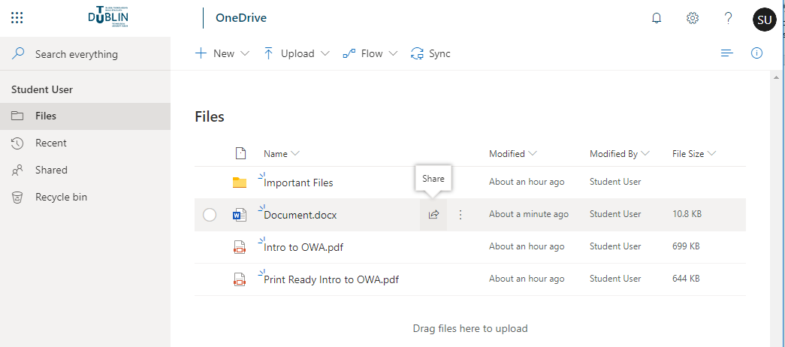
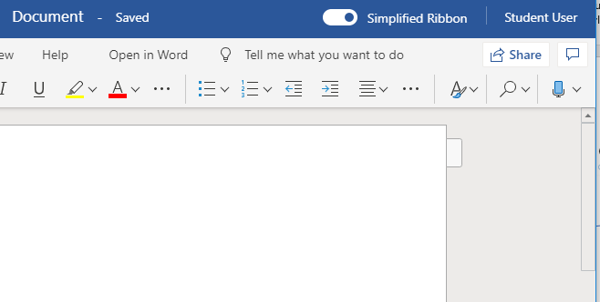
How to share documents from OneDrive
There are a few ways to share documents from OneDrive.
You can share documents from the OneDrive landing page or Folder navigation by moving your mouse over the file and clicking the share button which will appear.
You can also share documents from within the web app. Once you have the document open you will see a share button on the top right hand corner of the page.
1
2

Slide 11
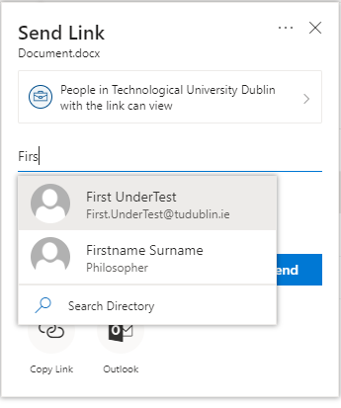
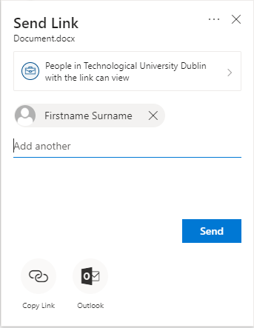
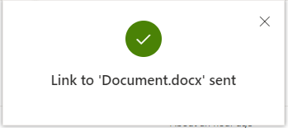
How to share documents from OneDrive continued
3. A dialog box for sharing will appear.
From here you can start to type a name in the Username or email address field. You will see suggestions for users based on what you type.
Once you click on a name it will be added to the list of users to share the document with.
You can continue to add other users by repeating the process and when you are finished click Send.
You will receive a confirmation that the document is shared.

