Slide 1

Gamification in Sustainability Education
putting the fun in fundamentals
Elaine Edmonds MSc Regeneration, Msc Spatial Planning, PG Dip Urban Design, BA Hon Natural Science

Slide 2
Gamification is a process
Why
Why did I create ‘the game of planning’
What
Where
Where do I use it now
How
How to approach gamifying classes
Introduction to the game

Slide 3

Why did I ‘Gamify’
-New Lecturer
-New Module (with no handover)
-Introductory class
-Gaps in background knowledge
-Lack of inherent interest
-Short timeline
Primarily… boredom

Slide 4
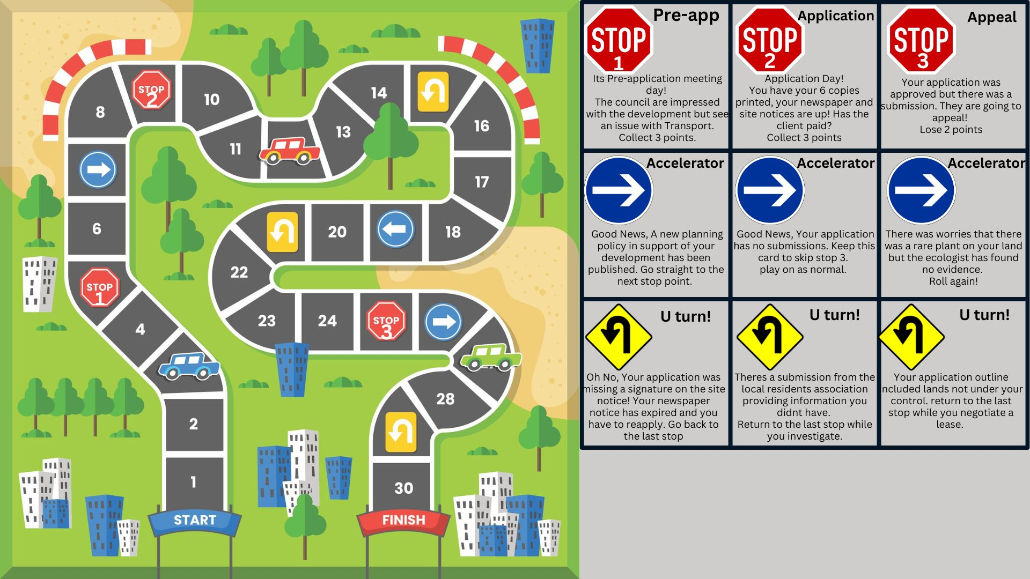
What
Simple dice roll game inspired by ‘The game of life’
Steps mirror steps in the process of planning
Roll a dice and pick a card, gather points

Slide 5
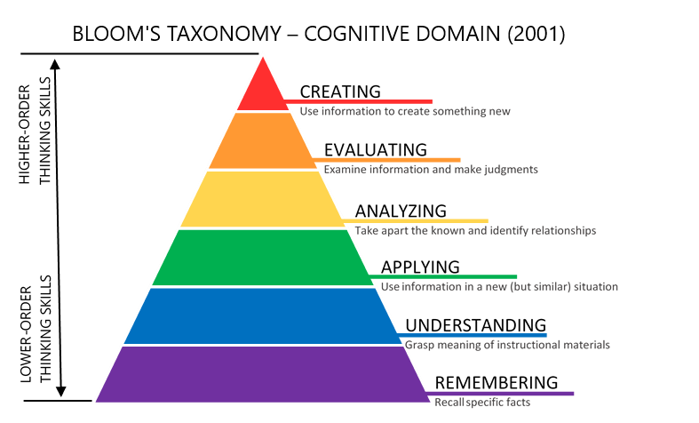
Where can I use the game?
Third use case-
System Analysis and creation
Masters classes expand the game
Second use case-
Communication Skills Example
4th year module on planning consultation
First use case-
Learning the process steps
Undergraduate introduction classes

Slide 6
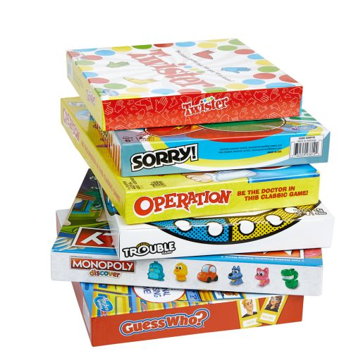
How I approached it
Facts and Figures-
Trivia games
Process and systems-
Roll and Move games
Analysis Skills-
Resources management, Engine builder or Eurogames
What was I trying to teach? eg
-Facts and Figures
-Processes and Systems
-Analysis Skills
What ‘real life’ games demonstrate that?
https://www.gameology.com.au/blogs/news/types-of-board-games-explained

Slide 7
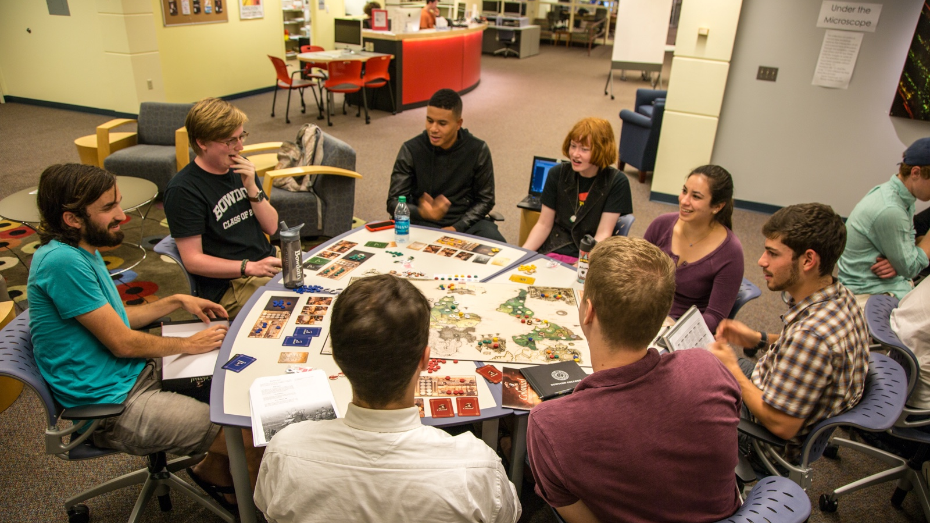
So when will you Gamify?

